Slide 1

Biology project Das Kuddlemuddle

Slide 2
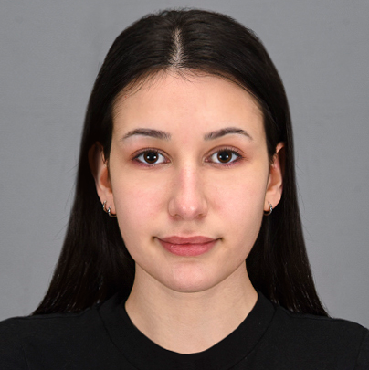
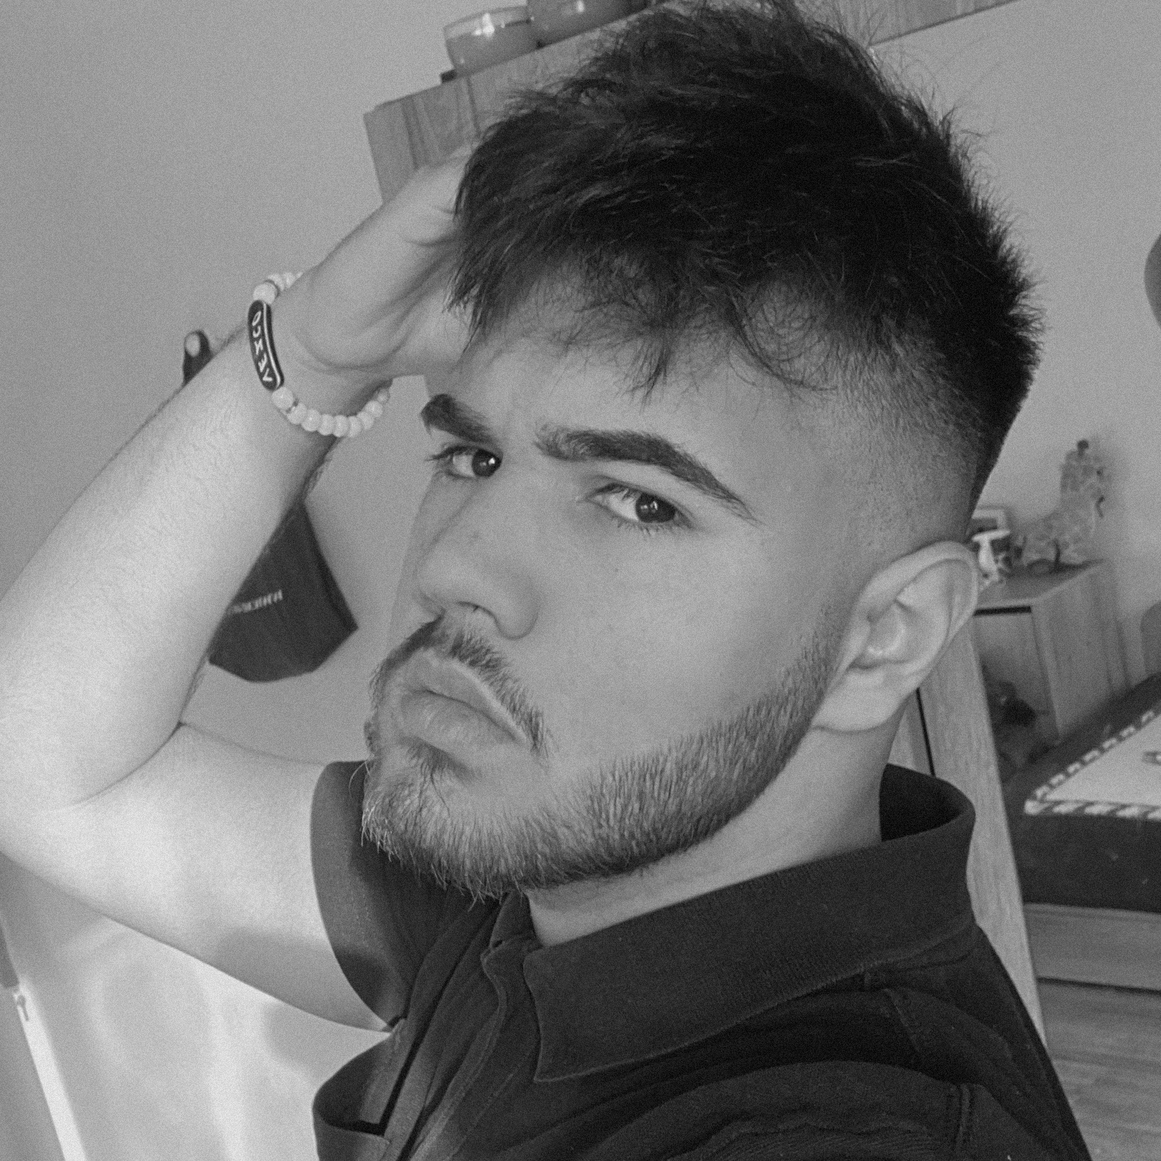
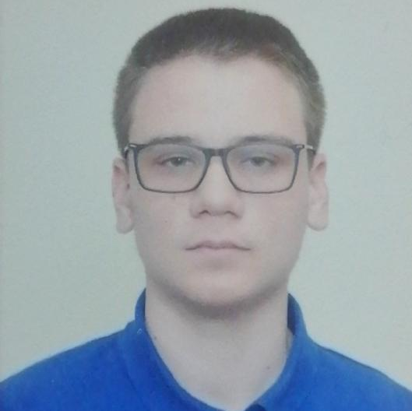
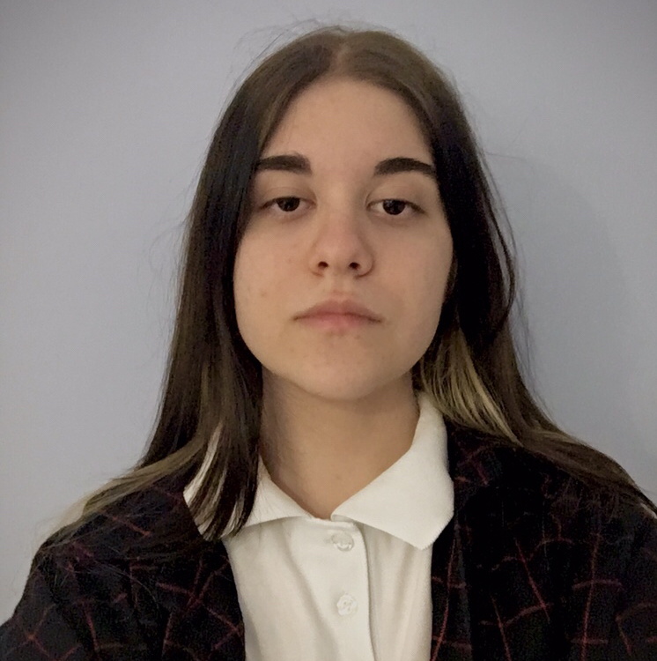
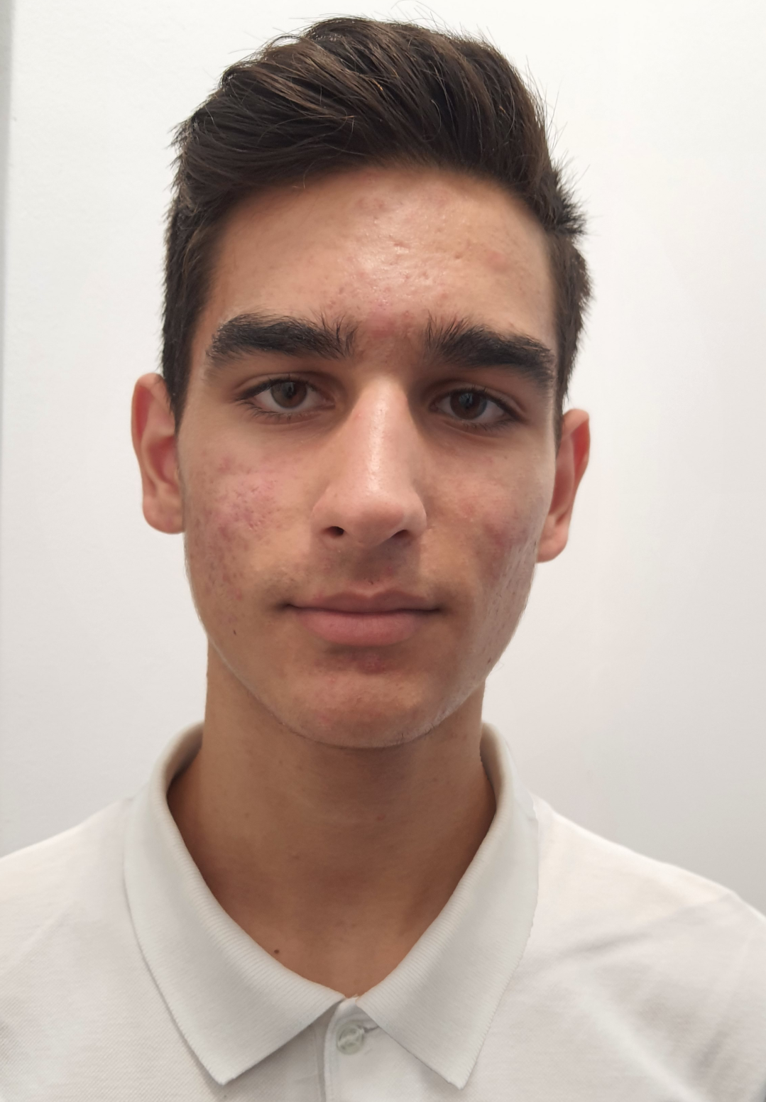
Team members
Yoanna Simeonova
Veselin Stoyanov
Stoyan Ivanov
Scrum Trainer
Front-end Developer
Back-end Developer
Tereza Opanska
Kostadin Taligadzhiev
Back-end Developer
QA Engineer

Slide 3
Summary of the project

Slide 4
Stages of realization
01
02
03
04
Team formation and idea
Development of the application
Documenting the project
Preparation for presenting

Slide 5







Used technologies
Database
Client
Server
QA
Visual Studio Native Unit Testing
JSON for Modern C++
CPR
libbcrypt
Docs
Log
Grayllogger
Deployment

Slide 6
Demonstration
Take a look at our application! :)

Slide 7
Thank you for the attention!
Feel free to ask any questions :)

